Slide 1
No more linguistic barriers with Microsoft Translator Speech
Marco Minerva
Microsoft MVP Windows Development
Riccardo Cappello
Microsoft MVP Microsoft Azure

Slide 2






Microsoft Cognitive Services
Give your apps a human side
Vision
From faces to feelings, allow your apps to understand images and video
Speech
Hear and speak to your users by filtering noise, identifying speakers, & understanding intent
Language
Process text and learn how to recognize what users want
Knowledge
Tap into rich knowledge amassed from the web, academia, or your own data
Search
Access billions of web pages, images, videos, and news with the power of Bing APIs
Labs
An early look at emerging Cognitive Services technologies: discover, try & give feedback on new technologies before general availability

Slide 3
Microsoft Cognitive Services
Give your apps a human side
Computer Vision
Content Moderator
Emotion
Face
Video
Video Indexer
Custom Vision Service
Bing Speech
Speaker Recognition
Translator Speech
Custom Speech Service
Bing Spell Check
Linguistic Analysis
Text Analytics
Translator Text
Web Language Model
Language Understanding
Academic Knowledge
Entity Linking
Knowledge Exploration
Recommendations
QnA Maker
Custom Decision Service
Bing Autosuggest
Bing Image Search
Bing News Search
Bing Video Search
Bing Web Search
Bing Entity Search
Bing Custom Search
Project Prague (gesture)
Project Cuzco (events)
Project Johannesburg (routing)
Project Nanjing (isochrones)
Project Abu Dhabi (distance matrix)
Project Wollongong (location)
Vision
Speech
Language
Knowledge
Search
Labs

Slide 4
Microsoft Cognitive Services
Give your apps a human side
Vision
Speech
Language
Knowledge
Search
Labs
Computer Vision
Content Moderator
Emotion
Face
Video
Video Indexer
Bing Speech
Speaker Recognition
Translator Speech
Bing Spell Check
Linguistic Analysis
Text Analytics
Translator Text
Web Language Model
Academic Knowledge
Entity Linking
Knowledge Exploration
Recommendations
QnA Maker
Bing Autosuggest
Bing Image Search
Bing News Search
Bing Video Search
Bing Web Search
Bing Entity Search
Project Prague (gesture)
Project Cuzco (events)
Project Johannesburg (routing)
Project Nanjing (isochrones)
Project Abu Dhabi (distance matrix)
Project Wollongong (location)
CUSTOMIZATION
Custom Vision Service
Custom Speech Service
Language Understanding
Custom Decision Service
Bing Custom Search

Slide 5
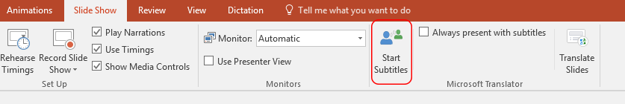
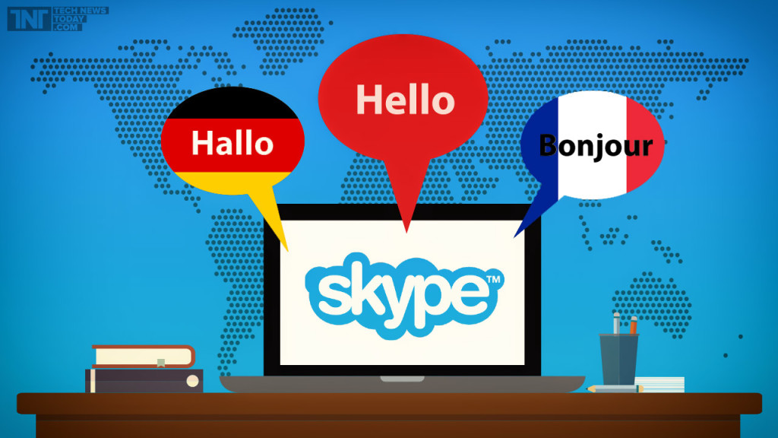



Real use cases
PowerPoint Presentation Translator
Skype Translator
Translator for Microsoft Edge
Translator for Outlook Add-In
Translator app

Slide 6
Demo!
https://www.bing.com/translator

Slide 7
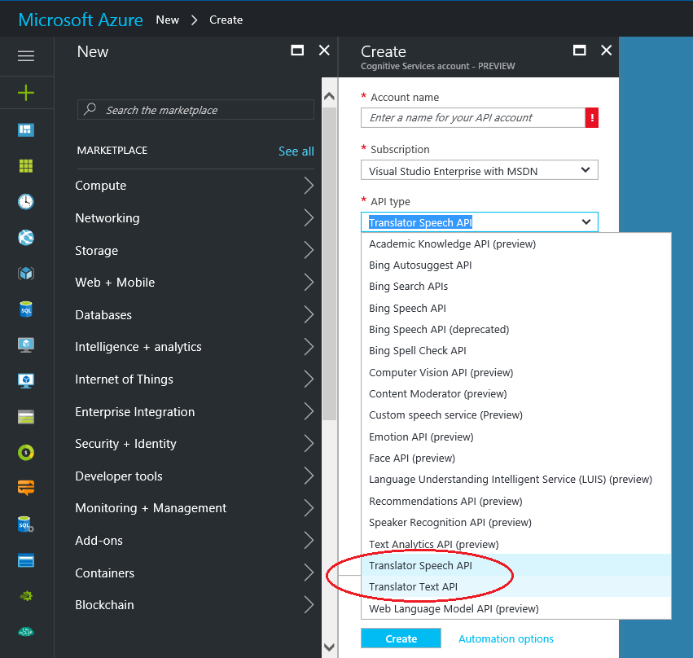
Service subscription
https://portal.azure.com/#create/Microsoft.CognitiveServicesSpeechTranslation
Free up to 10H of audio
Pay as you go

Slide 8
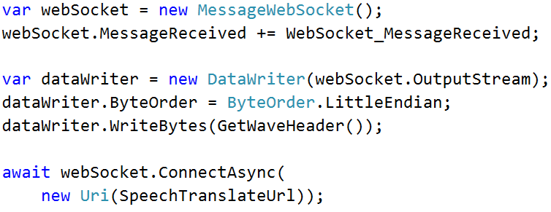
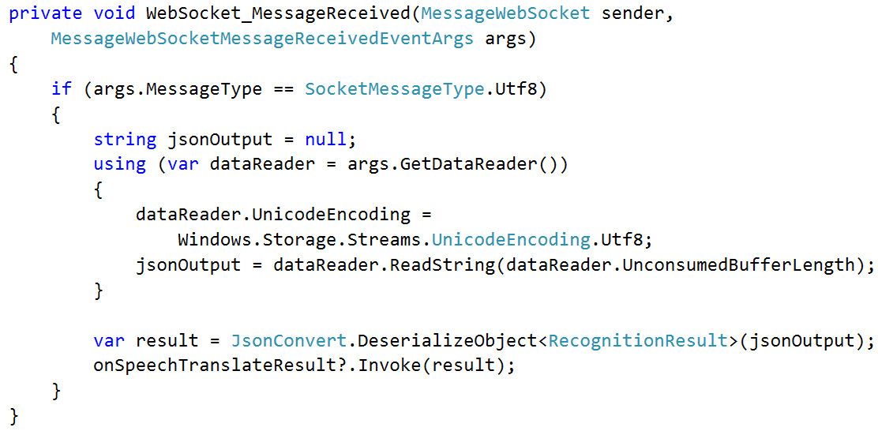
Let’s see some code

Slide 9
Demo!
Babel Fish

Slide 10
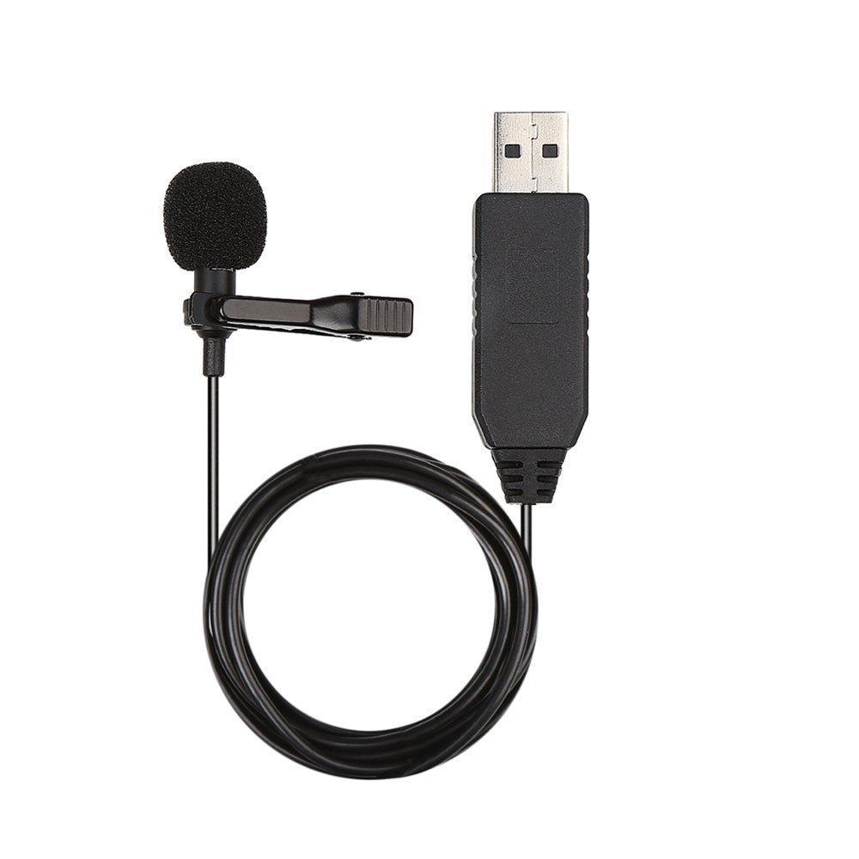
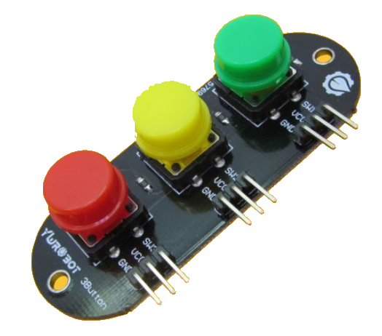
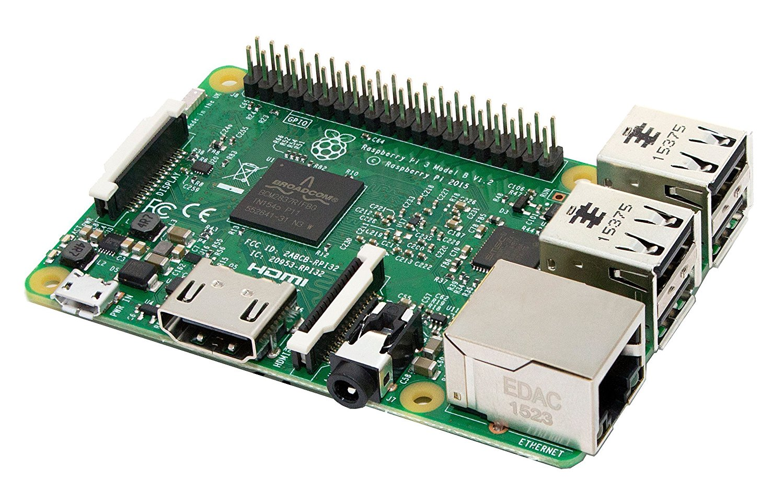

The Windows 10 IoT Core version
Raspberry Pi 3
Buttons
USB Microphone
Speaker

Slide 11
Demo!
Babel Fish on Windows 10 IoT Core

Slide 12
References
https://www.microsoft.com/en-us/translator/speech.aspx
https://docs.microsofttranslator.com/speech-translate.html
https://github.com/marcominerva/BabelFish

Slide 13
Create Productive Apps with Office 365
Giancarlo Lelli

